Slide 1
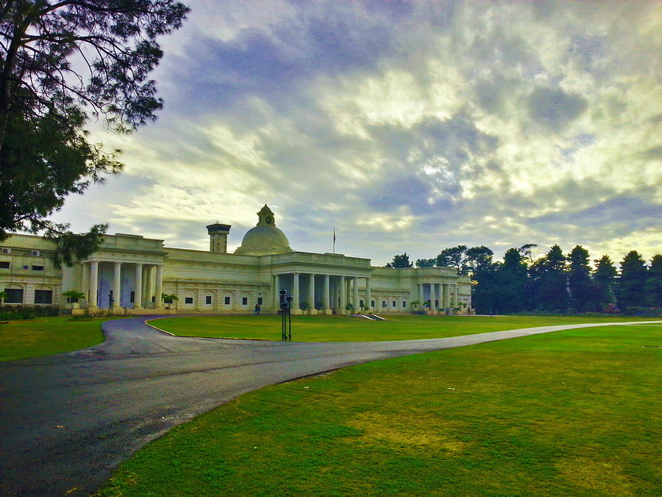
AIChE IIT Roorkee Student Chapter

Slide 2

AIChE
Chemicals & Materials
Energy
Sustainability & Environment
Biological Engineering
Process Safety
Chemical Engineering practice

Slide 3


On a global scale, such chapters have been established over 100 campuses and more than 70 countries.
There are many chapters in our country namely IIT Gandhinagar, NIT Surat, VIT, Thapar University, IIT Madras.
Some of them have been member of AIChE for the past 3-4 years. Acknowledged for their work, they have bagged a good name and reputation in a short span.
Each year, heavy participation has been seen in AIChE by these campuses.

Slide 4
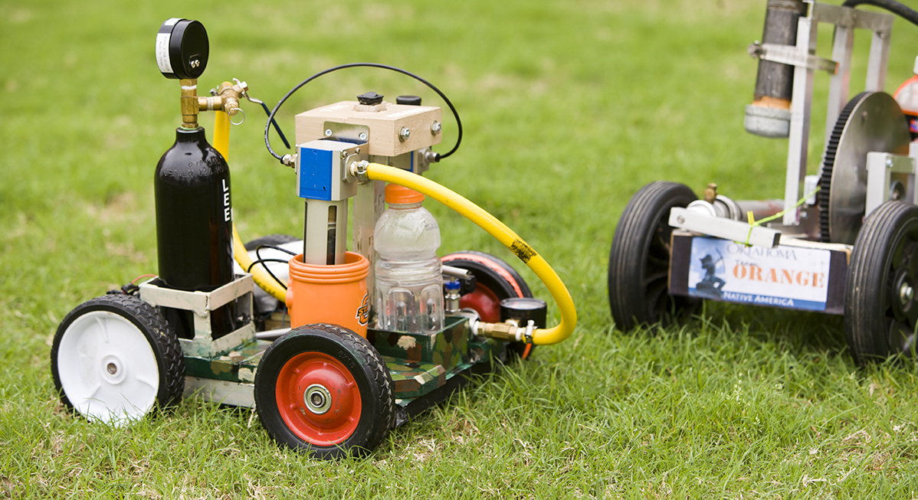
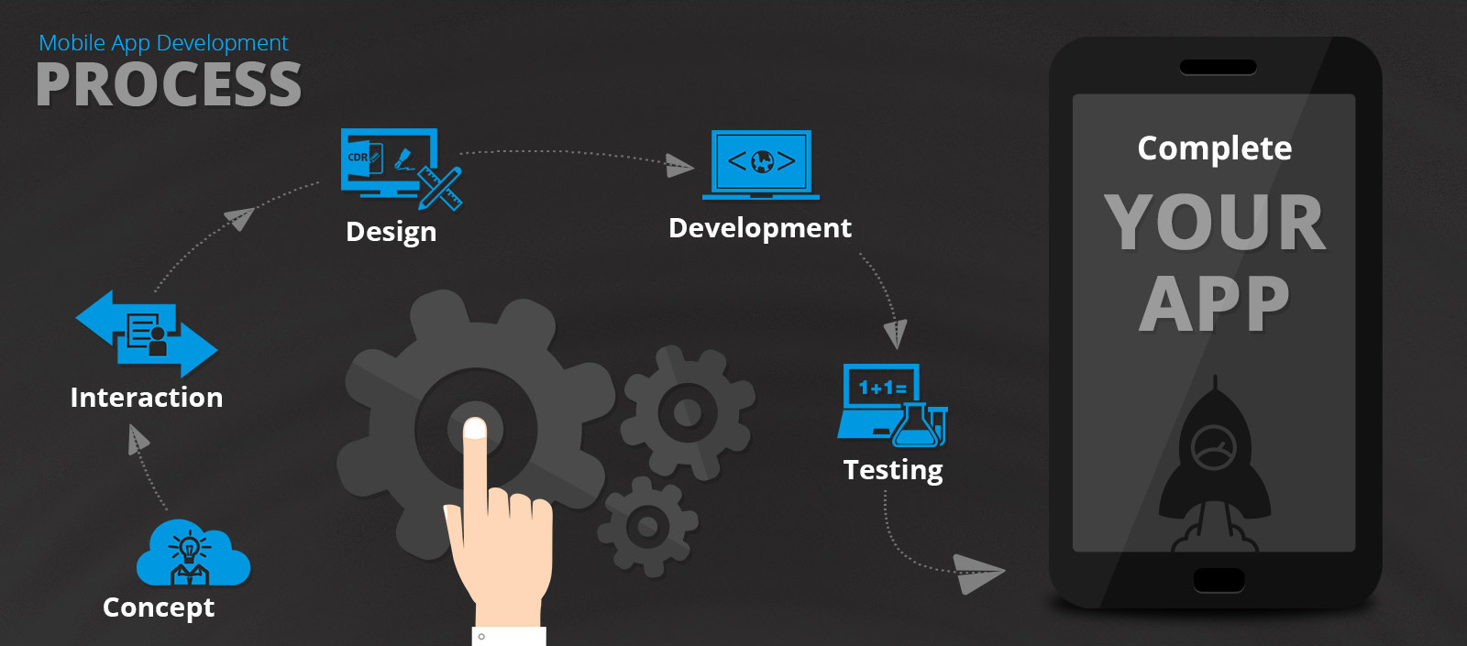
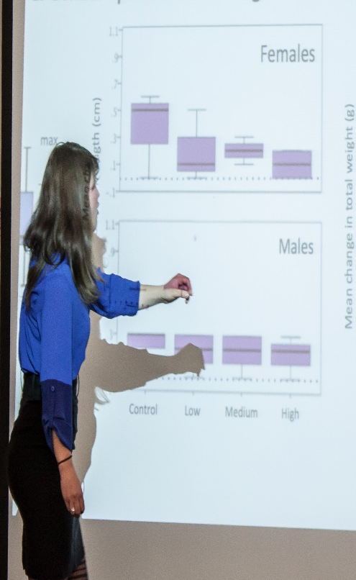
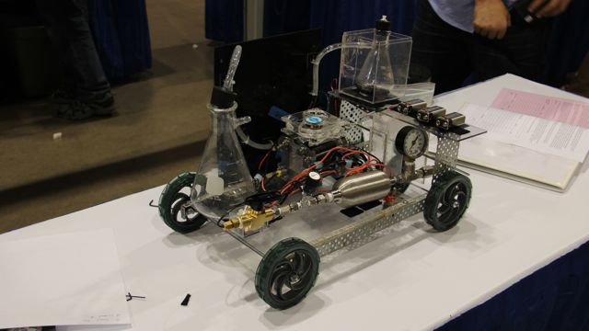
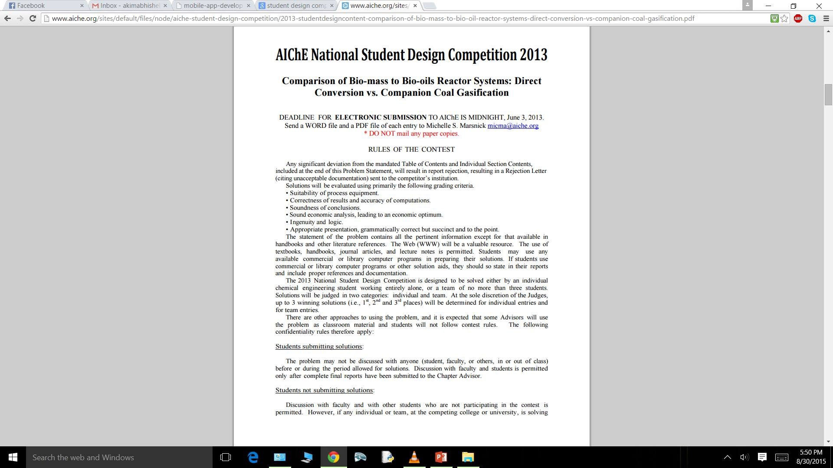
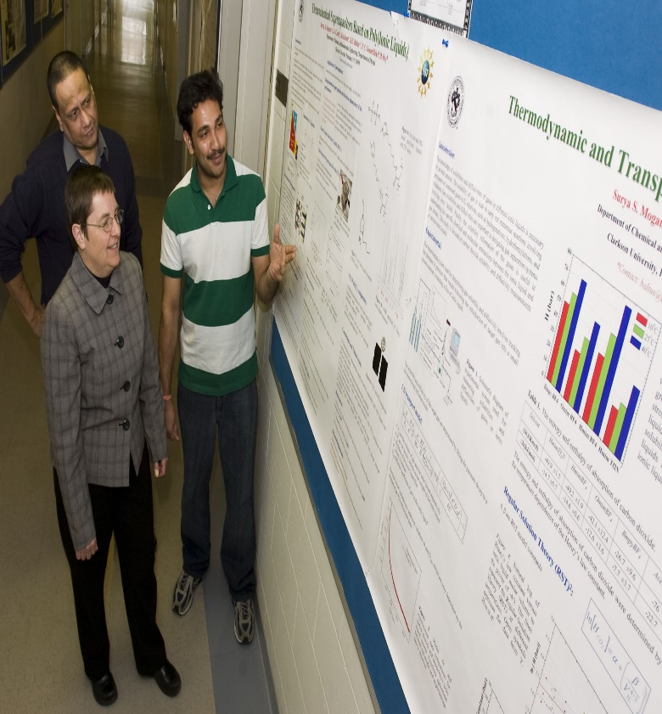
Events by AIChE

Slide 5
CHEM-E-CAR
Team will design and construct a chemically powered vehicle which will carry a specified cargo.
Teams compete at the regional conferences, and the winner of each regional conference will compete at the national conference.

Slide 6
SBE Chem-E-Car (Biological Reaction)
Team will design and construct a chemically powered vehicle by a biological reaction which will carry a specified cargo.
Teams compete at the regional conferences, and the winner of each regional conference will compete at the national conference.

Slide 7
AIChE National Student Design Competition
In this competition, students have to design real, working, chemical engineering situation(problem statement given by a company).
The problem's solution requires calculation and evaluation of both technical data and economic factor.
The SAChE award is presented to team and individuals for designs that apply appropriate principles of chemical process safety.

Slide 8

Global UG Student Video Competition
Student chapter teams will create a 2-5 minute video that explains about chemical engineers and what they do.
Each video will compete to win a judges choice award or a public choice award. The winners of each year’s competition will be announced at Annual Student Conference.
Topic of 2015 competition: How an Oil Refinery Works (Separation-Conversion-Purification).

Slide 9
Mobile Device App Competition
Undergraduate student teams will create an APP for a mobile device. Possible application areas include scientific, engineering, teaching and professional meeting organizers.
Teaching apps could include a game designed to teach chemical engineering concepts.
The APP that is developed must be able to run on a mobile device such as a smartphone (iPhone, Android, Blackberry etc).

Slide 10
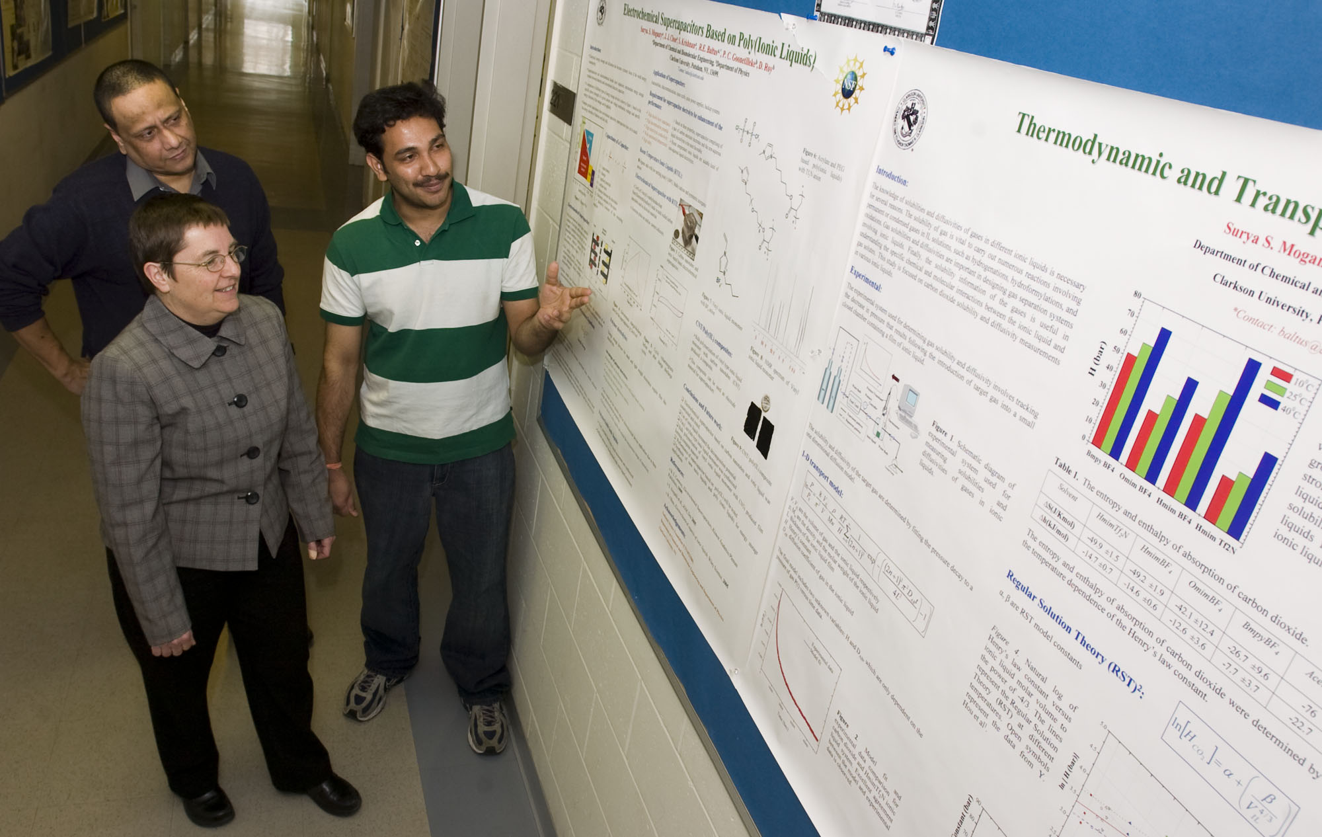
Student Poster Competition
The subject of each paper is left entirely to the individual student. Presentations often focus on recent advances in some branch of chemical engineering, original research, or plant design.
Participation in the Paper Competition offers valuable, real-world experience for students.
Participants are selected on the basis of regional conference results.

Slide 11
Internship Oppurtunities Through AIChE!!
There are lots of programmes and schemes going on in AIChE which can provide internships to undergraduate students.
Some of them are:
1.) Washington Internships for Students in Engineering (WISE)
2.) AIChE Young Professionals Online Home
3.) AIChE WISE Intern is Awarded NSF Graduate Research Fellowship
4.) Women's Initiatives Committee (WIC)

Slide 12
Internships
Certain steps to be followed:
1.)Get student membership and become an active member of the chapter.
2.)Make your internship account on AIChE.
3.)View all kinds of internships.
4.) Post your resume onto it.
5.)Get personal internship alerts.

Slide 13
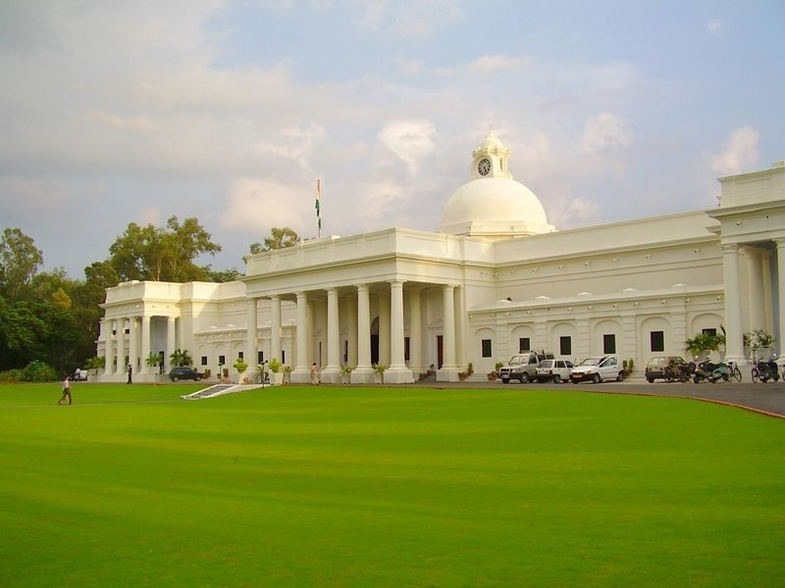
Our Aim
@ AIChE I.I.T. Roorkee Student Chapter

Slide 14

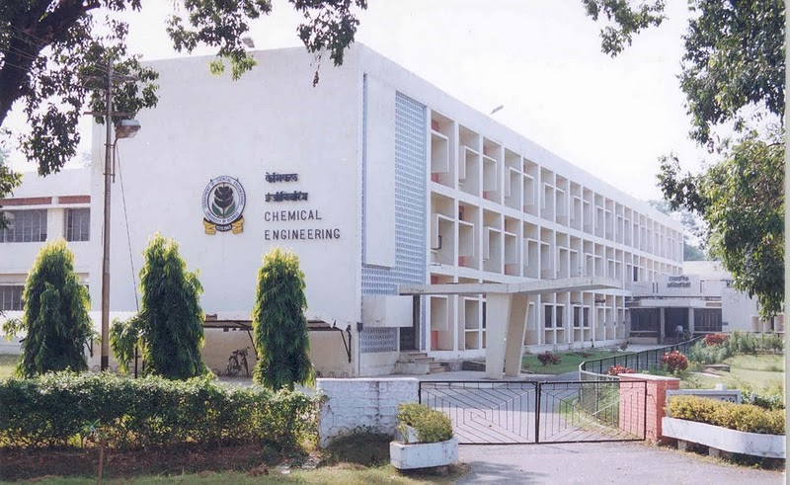
To promote advancement of Chemical Engineering Science.
To maintain and widen contacts with the industry experts related to the field in India and abroad.
Ensure regular exchange of ideas with other national and international professionals of Chemical Engineering.

Slide 15
REPRESENTATION OF IITR AT INTERNATIONAL LEVEL
STEP 1:
Our first aim in participating competitions will be to participate in the regional events and give a solid performance there.
STEP 2:
After some nice perfomances in these events, we will move one step above for competition and participate in the Main Events of AIChE where there is cut throat competition.
STEP 3:
We are also planning to organize AIChE’s main events in our campus in near future(most probably in 2017) after completing the first two objectives satisfactorily.
Our department and especially IIT Roorkee has got all the potential to get a special attention on a global scale as we carry out all the above steps in the best possible way.

Slide 16

COMPETITIONS IN CAMPUS
All the AIChE’s competitions will be held
in Cognizance.
AIChE’s competitions will also be held in the campus amongst the students of IIT Rooekee. These events are broadly classified in two parts:
1.) Events in Autumn Semester: for many of the first yearites, this branch will be quite new. So the events mainly will be such that they can explore the branch, know more about it and develop a greater interest in chemical engineering.
2.)Events in spring semester: Mainly model making events will be focused in this semester.

Slide 17
ADDITIONAL FEATURES…
● We are also intending to start new Sister Chapters with some reputed institutes.
-Interact with other Student Chapters
-Stream their conferences and talks in our campus.
● AIChE Academy and eLibrary
-Access to courses, webinars, conference presentations and more.
-Unlimited access to entire textbooks as PDFs and various journals.

Slide 18
ADDITIONAL FEATURES (cont.)
● Workshops and Seminars by faculties and local industry experts.
● Computer Courses:computer programming, Matlab, Hysys and Polymath, Java tutorials.
● Exposure and Practical application to students. Interaction between junios and seniors in campus.
● Develop project manangement and program planning skills.

Slide 19
Requirement to become a new AIChE student chapter
12 student members – at least twelve students from the university must become AIChE student members
One faculty member – the chapter’s faculty advisor must be an AIChE member
Letters of support on university letterhead from the advisor and department chair
Copy of bylaws for the student chapter: a template is attached
Tentative list of future activities: a list of possible student activities is attached

Slide 20
TENTATIVE TEAM STRUCTURE
TEAM STRUCTURE
Technical members
(6)
Marketing members
(5)
Promotion and Organizing members
(5)
Web developers & designers
(2)
Faculty Advisor
(Vimal Kumar)
Note: Organizing of events in the campus will be done by all the members of the chapter.

Slide 21
Other Requirements
Availability of Lab
Funding for Organizing Events
AIChE bank account
Building-up of website

Slide 22


